Slide 1


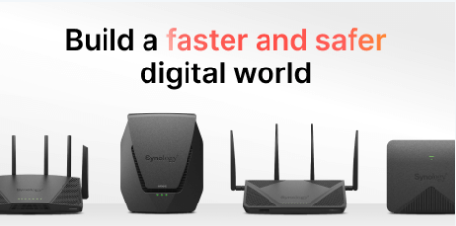
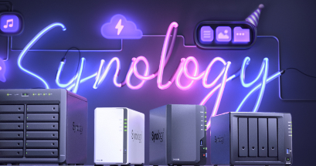
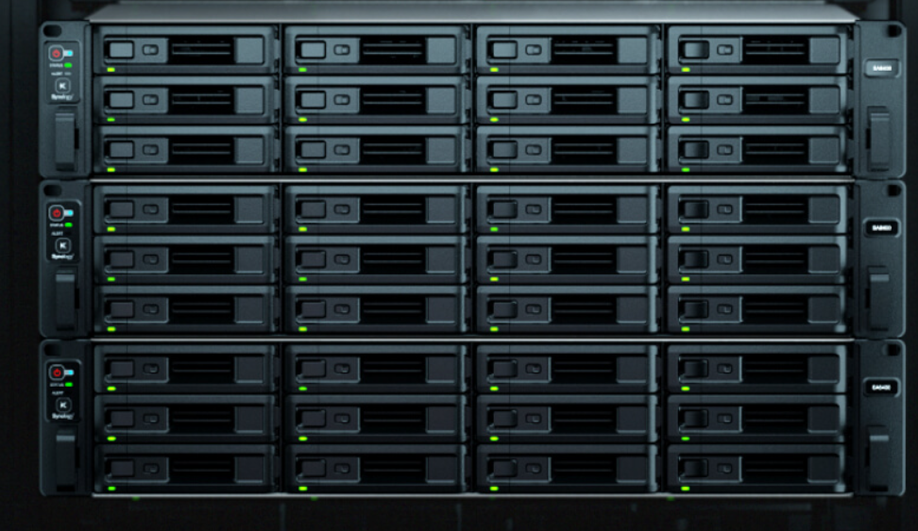
Synology
About Synology
Synology NAS market COMPETITORS
Product and Services
Synology business model
Servers Overview
Synology Servers
Synology Customers
Synology SMB customers
Benefits of Synology Servers to SMB customers
NAS solution overview
Synology NAS solution
Synology Competitors research
Advantages of Synology over competitors NAS solution
Market trends in NAS solution
Conclusion

Slide 2
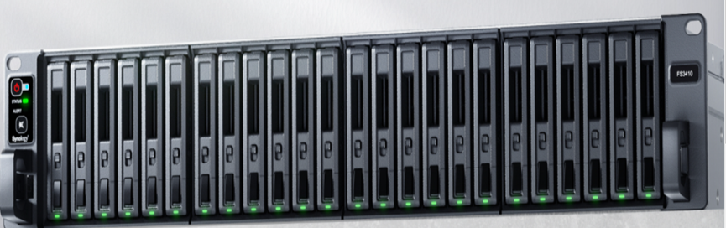
About Synology
Introduction to Synology as a company
Synology is a Taiwanese technology company that specializes in network-attached storage (NAS) devices, software, and services. Founded in 2000, Synology has since become a leader in the NAS market, with a reputation for delivering high-quality and user-friendly products. Synology is recognized as a leader in the NAS market, with a reputation for delivering high-quality products and excellent customer support.
History and background of Synology
Synology was founded in 2000 by Cheen Liao and Philip Wong, two former Microsoft employees. The company initially focused on developing custom software solutions for businesses, but quickly shifted its focus to network-attached storage (NAS) devices. In 2004, Synology released its first NAS product, the DS-101, which was well-received by the market for its user-friendly interface and powerful features.
Mission and vision statement
Synology's mission is to provide reliable and affordable storage solutions for businesses and individuals, while continuously improving the user experience and expanding its product offerings. Synology's vision is to empower users to store, manage, and protect their data, while enabling collaboration and productivity across organizations and industries.

Slide 3



Synology NAS Market Competitors
Competitors
QNAP Systems
Western Digital
Netgear
Seagate Technology
Buffalo Americas

Slide 4

Synology Product and Services
Overview of Synology’s products and services
Synology's products and services can be grouped into the following categories:
NAS Devices: Synology offers a wide range of NAS devices that vary in capacity, performance, and features.
DiskStation Manager (DSM): DSM is Synology's operating system for NAS devices
Apps and Services: Synology offers a range of apps and services that can be installed on its NAS devices.
Router: Synology also offers a router that includes features such as parental controls, VPN support, and network security.
Other Products: Synology has expanded its product line to include other devices such as wireless access points, IP cameras, and expansion units for its NAS devices.
Explanation of Synology’s services and support options
Synology provides a range of services and support options to its customers, aimed at helping them get the most out of their Synology products. Here are the key services and support options offered by Synology:
Synology Account: Customers can create a Synology Account to access Synology's online services.
Technical Support: Synology offers technical support to customers through various channels, including email, phone, and online chat.
Knowledge Base: Synology provides a comprehensive knowledge base on its website, which includes articles, FAQs, and tutorials on various topics related to Synology products.
Online Communities: Synology has an active online community of users who share their experiences, tips, and solutions related to Synology products, such as Facebook and Reddit.
Warranty and Repairs: Synology offers a limited warranty for its products, which covers defects in materials and workmanship for a specified period of time.

Slide 5
Synology Business Model
Explanation of Synology’s business model
key elements of Synology's business model
Hardware sales: Synology sells NAS devices, which are physical hardware units that allow users to store and access data from a centralized location.
Software sales: Synology's NAS devices run on the company's proprietary operating system, DiskStation Manager (DSM). The company also offers a range of software applications that can be installed on their NAS devices.
Recurring revenue: Synology offers a subscription service called Synology C2, which provides cloud backup and file sharing services to customers.
Ecosystem development: Synology has a strong focus on developing an ecosystem around their products, with a range of third-party applications and add-ons available for their NAS devices.
Overall, Synology's business model is centered around providing high-quality, customizable NAS solutions for businesses and individuals, while also generating recurring revenue through software sales and subscription services.
Synology’s target customers
primarily small and medium-sized businesses (SMBs) , prosumers (professional consumers), and large enterprises.
Synology’s sales channels
Here are some of Synology's main sales channels:
Online store, Resellers, Retail stores, E-commerce platforms, and Direct sales.
Overall, Synology utilizes a variety of sales channels to make its products available to customers worldwide.

Slide 6
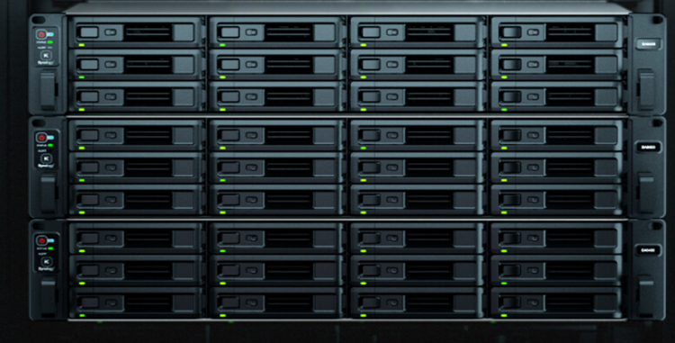
Servers Overview
Explanation of servers in the IT industry
A server refers to a computer or a device that provides services or resources to other computers or devices on a network. The term "server" can refer to both the hardware and the software that provides services or resources.
Servers can serve different functions depending on the needs of an organization. Some common types of servers include:
File server
Web server
Email server
Database server
Application server
In addition to these common types, there are many other types of servers that provide different types of services and resources to other devices on a network. Servers are an essential component of most IT infrastructures, and they play a crucial role in enabling communication, collaboration, and resource sharing between devices and users.

Slide 7
Synology Servers
Explanation of Synology servers
Here are some key features and capabilities of Synology servers:
Scalability: Synology servers are designed to be highly scalable, with the ability to add more storage and processing power as your business needs grow.
Security: Synology servers offer a range of advanced security features, including multiple layers of protection against unauthorized access and data breaches, as well as support for encryption and other security protocols.
Backup and Recovery: Synology servers are designed to provide reliable backup and disaster recovery solutions, with options for both local and offsite backup, as well as automatic backup and recovery of critical data.
Collaboration and Sharing: Synology servers offer a range of collaboration and sharing tools, including file sharing, document management, and version control, to help teams work more efficiently and effectively.
Virtualization: Synology servers can be used for virtualization, enabling businesses to run multiple virtual machines on a single server and making it easier to manage and scale their IT infrastructure.
Application support: Synology servers support a range of business applications, including email, web hosting, database management, and more, making it easy to run and manage a wide range of business-critical applications on a single server.
Overall, Synology servers are designed to provide businesses and enterprise-level users with a flexible, scalable, and secure platform for managing their data, applications, and IT infrastructure.

Slide 8
Synology Customers
For small and medium-sized businesses, Synology offers a range of NAS devices that can store and share data, backup important files, and provide remote access to data. The company also offers solutions for network security, surveillance, and virtualization.
In the media and entertainment industry, Synology's products are designed to support the storage and sharing of large media files. Its devices can be used for video production, media archiving, and live streaming.
In the education sector, Synology provides solutions for managing digital classrooms, supporting online learning, and storing and sharing large educational files.
In the healthcare industry, Synology offers secure storage and sharing solutions for electronic health records (EHRs), medical images, and other sensitive data.
In the government sector, Synology's products are designed to meet the strict security requirements of government agencies. Its devices can be used for secure data storage, backup, and disaster recovery.
For home users, Synology offers a range of NAS devices that can be used for media streaming, data backup, and remote access to data.
Synology's customer loyalty can be attributed to several factors. The company is known for its high-quality products, innovative features, and excellent customer service.

Slide 9
Synology SMB Customers
SMB stands for Small and Medium-sized Businesses, which are companies with typically fewer than 500 employees. SMBs are an important customer segment for Synology as they require reliable and cost-effective data management solutions to support their business operations.
SMB customers have specific needs and preferences when it comes to data management. They require solutions that are easy to use, affordable, and scalable. They also need a high level of data security and protection, as their data is often critical to their business operations. Additionally, SMBs need solutions that are flexible and can be customized to meet their specific requirements.
Synology's SMB customer base is made up of a diverse range of companies from various industries, including healthcare, finance, education, retail, and more. Synology's products are designed to meet the unique needs of SMBs, with a focus on affordability, scalability, and ease of use.
For SMBs, Synology offers a range of NAS devices that can store and share data, backup important files, and provide remote access to data. The company also offers solutions for network security, surveillance, and virtualization. Synology's products are designed to be easy to set up and use, with a user-friendly interface and intuitive management tools.
To meet the needs of SMBs, Synology also provides extensive support resources, including online forums, documentation, and support services. Synology's support team is knowledgeable and responsive, providing fast and effective solutions to any issues that may arise.
Overall, Synology has a strong focus on SMBs and provides comprehensive solutions to meet their specific needs. The company's dedication to innovation, customer support, and affordable pricing has earned it a loyal following among SMBs, and the company continues to invest in new products and features to meet the evolving needs of this important customer segment.

Slide 10
Benefits of Synology Servers to SMB Customers
One of the key benefits of Synology servers is cost-effectiveness. SMB customers typically have a limited budget and need solutions that are affordable without compromising on quality. Synology servers provide a cost-effective solution to store and manage data, with lower hardware and maintenance costs compared to traditional server solutions.
Another benefit of Synology servers is scalability. As SMBs grow, their data storage needs also increase. Synology servers are designed to scale easily and can be expanded as needed, without the need for significant hardware upgrades.
Synology servers also provide a high level of data security and protection. SMBs need to protect their data from cyber threats and potential data loss. Synology servers offer a range of security features, including data encryption, backup and recovery, and integrated antivirus solutions.
Flexibility is another benefit of Synology servers. SMBs need solutions that can be customized to meet their specific needs. Synology servers can be configured to meet a range of use cases, including file sharing, backup and recovery, virtualization, and more.
Real-life examples of how SMB customers have benefited from Synology servers include:
A small marketing agency in the US used Synology servers to store and share files between team members. They were able to set up the system quickly and easily, with minimal IT support. The agency was able to access files remotely and collaborate more efficiently.
A UK-based manufacturing company used Synology servers to store and manage their CAD files. With Synology servers, the company was able to scale their storage as their data needs increased, without the need for expensive hardware upgrades.
A healthcare provider in Canada used Synology servers to store and protect their electronic health records. With Synology servers, the provider was able to meet strict data security and privacy requirements, while also providing easy access to patient data for healthcare professionals.
.

Slide 11
NAS Solution Overview
There are different types of NAS solutions available, each with its own features and capabilities. The main types of NAS solutions are:
Consumer NAS: These are typically smaller, more affordable NAS devices designed for home use.
SMB NAS: These are NAS devices designed for small and medium-sized businesses
Enterprise NAS: These are NAS devices designed for large businesses and enterprises.
NAS solutions come with a range of features and capabilities, including:
Storage capacity: NAS solutions can be configured with a range of storage capacities, from a few terabytes to multiple petabytes.
RAID: NAS solutions typically support RAID (Redundant Array of Independent Disks) for data protection and redundancy.
Remote access: NAS solutions can provide remote access to data, allowing users to access data from anywhere with an internet connection.
Backup and recovery: NAS solutions often come with backup and recovery features to protect data in the event of hardware failure or data loss.
Virtualization: NAS solutions can support virtualization, allowing multiple virtual machines to run on a single NAS device.
Security: NAS solutions typically come with security features such as encryption, access control, and antivirus protection.
Cloud integration: NAS solutions can integrate with cloud services such as Dropbox, Google Drive, and Amazon S3, allowing users to backup and sync data to the cloud.

Slide 12
Synology NAS Solution
Synology's NAS product line includes:
DiskStation: These are NAS devices designed for home and small office use.
RackStation: These are rack-mounted NAS devices designed for small and medium-sized businesses.
FlashStation: These are high-performance NAS devices designed for businesses with demanding workloads, such as video editing and 3D rendering.
SA Series: These are NAS devices designed for enterprise use, offering features such as high availability, data deduplication, and encryption.
Synology's NAS solutions come with a range of features and capabilities, including:
Storage capacity: Synology's NAS devices can be configured with a range of storage capacities, from a few terabytes to multiple petabytes.
RAID: Synology's NAS devices support a range of RAID configurations for data protection and redundancy.
Virtualization: Synology's NAS devices can support virtualization, allowing multiple virtual machines to run on a single device.
Remote access: Synology's NAS devices provide remote access to data, allowing users to access data from anywhere with an internet connection.
Backup and recovery: Synology's NAS devices offer a range of backup and recovery features, including versioning, incremental backup, and snapshot replication.
Security: Synology's NAS devices come with a range of security features, including encryption, access control, and antivirus protection.
Cloud integration: Synology's NAS devices can integrate with cloud services such as Dropbox, Google Drive, and Amazon S3, allowing users to backup and sync data to the cloud.

Slide 13
Synology Competitors Research
NAS Market Competitors Research
QNAP: QNAP is a Taiwanese company that offers a range of NAS solutions for home and business use.
Western Digital: Western Digital is a US-based company that offers a range of NAS solutions under the "My Cloud" brand.
Netgear: Netgear is a US-based company that offers a range of NAS solutions for home and business use
Seagate: Seagate is a US-based company that offers a range of NAS solutions under the "IronWolf" brand.
Competitors in the NAS market have different strengths and weaknesses. For example:
QNAP's NAS products are known for their high performance and advanced features, such as virtualization and video transcoding. However, QNAP's NAS products can be more expensive than some competitors.
Western Digital's NAS products are known for their affordability and ease of use, making them a popular choice for home users. However, Western Digital's NAS products may not offer the same level of advanced features as some competitors.
Netgear's NAS products are known for their advanced features and ease of use, making them a popular choice for small businesses. However, some users have reported issues with the reliability of Netgear's NAS products.
Seagate's NAS products are known for their high performance and data protection features, such as RAID and encryption. However, Seagate's NAS products may be more expensive than some competitors.

Slide 14
Advantages of Synology Over Competitors NAS Solution
When comparing Synology's NAS solutions to those of its competitors, there are several advantages that Synology has over its competitors.
Ease of use: Synology's DSM operating system is known for its intuitive and user-friendly interface, making it easy for users to manage and configure their NAS devices.
Flexibility and customization: Synology's NAS solutions offer a high degree of flexibility and customization, allowing users to tailor their NAS devices to their specific needs.
App ecosystem: Synology's app ecosystem is extensive, with over 100 apps available for download, including media streaming, backup and recovery, and file sharing.
Customer support: Synology is known for its excellent customer support, providing users with a range of resources, including an online knowledge base, community forums, and email and phone support.
Integration with other systems: Synology's NAS solutions can integrate with a range of other systems and services, such as cloud storage services, surveillance systems, and backup and recovery services.
Real-life examples of how Synology has outperformed its competitors include:
Ease of use: A user review on Amazon noted that Synology's DSM operating system was easier to use and had better features than QNAP's QTS operating system.
App ecosystem: A user review on Capterra noted that Synology's app ecosystem was more extensive than Western Digital's My Cloud app ecosystem.
Flexibility and customization: A user review on TechTarget noted that Synology's NAS solutions were more flexible and customizable than Netgear's ReadyNAS solutions.

Slide 15
Market Trends in NAS Solution
Trends and future projections in the NAS market
Here are some short trends and future projections for the NAS market:
Cloud-based NAS: Cloud-based NAS is becoming more popular due to its scalability and cost-effectiveness
Big Data: The growth of big data and analytics is driving the need for more powerful and scalable NAS solutions.
Data Security: Data security is becoming increasingly important, and NAS solutions that offer enhanced security features, such as encryption and access controls,
Hybrid Cloud: A hybrid cloud approach, which combines both public and private cloud solutions with on-premise infrastructure, is gaining popularity.
Overall, the NAS market is expected to continue growing in the coming years, driven by the need for efficient and secure data storage
and management solutions. The market is expected to be worth $45.21 billion by 2025, growing at a CAGR of 20.5% from 2020 to 2025.

Slide 16
Conclusions
Synology's products are known for their reliability, user-friendly interface, and One of Synology's competitive advantages is their focus on creating user-friendly products with a wide range of features. Their devices come with intuitive web-based interfaces that make it easy for users to set up and manage their NAS devices, and their software solutions are designed to work seamlessly with their hardware.
Another advantage is Synology's commitment to security. They offer a range of security features, such as two-factor authentication, access control, and data encryption, to help users protect their data.
In terms of future growth, Synology has several plans in place. They are focused on expanding their product offerings, with a particular emphasis on solutions for larger organizations and enterprise customers. They also plan to continue to improve their software solutions and expand their cloud-based offerings.
Potential customers looking for a reliable and user-friendly NAS solution should consider Synology. Synology's products offer a wide range of features, including data backup, cloud integration, multimedia streaming, and virtualization. They are known for their reliability and user-friendly interface, and they offer a range of security features to protect users' data. With their commitment to innovation and focus on creating products that meet the changing needs of customers, Synology is a strong choice for those in need of a server and NAS solution provider.

